Slide 1

World
Your Logo
Unsolved
Mystery
of
MM/DD/20XX

Slide 2
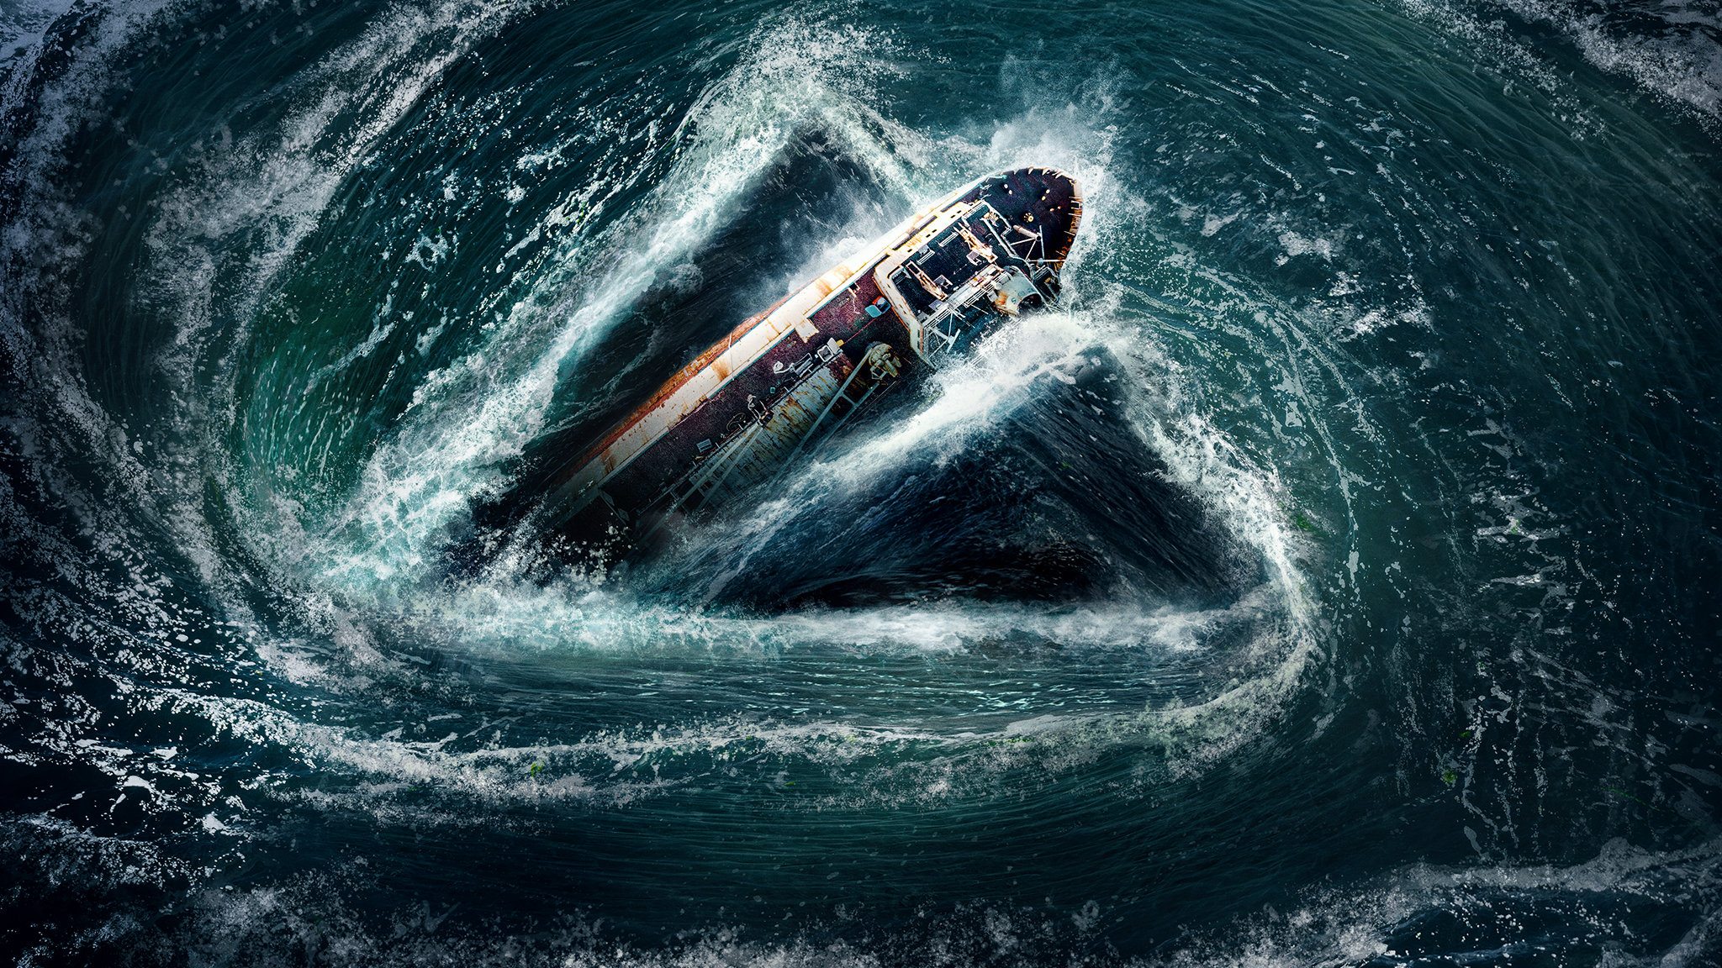
Bermuda triangle
It is also known as Devils Triangle…A region in the Atlantic ocean where ships and planes mysteriously disappear without a trace…

Slide 3

The Wow! Signal
A strange soung was detected in1977
scientists tried to find it again,but it was never repeated…Many believe it may be Alien Civilization

Slide 4
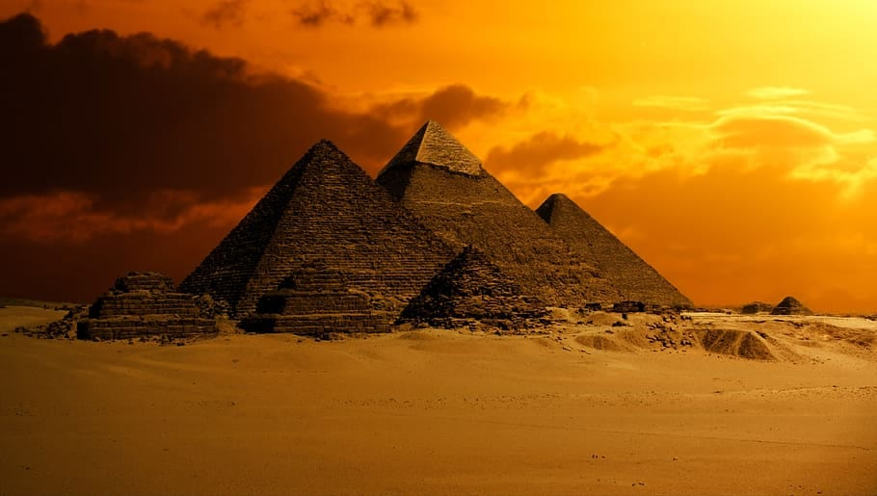
The Pyramids of Egypt
Historians still don’t know how the ancient Egyptians built such huge structures with perfect alignment using only simple tools…. yet there is no idea how they placed the stones…it was the tallest man-made structure in the world for over 3800 years!!

Slide 5
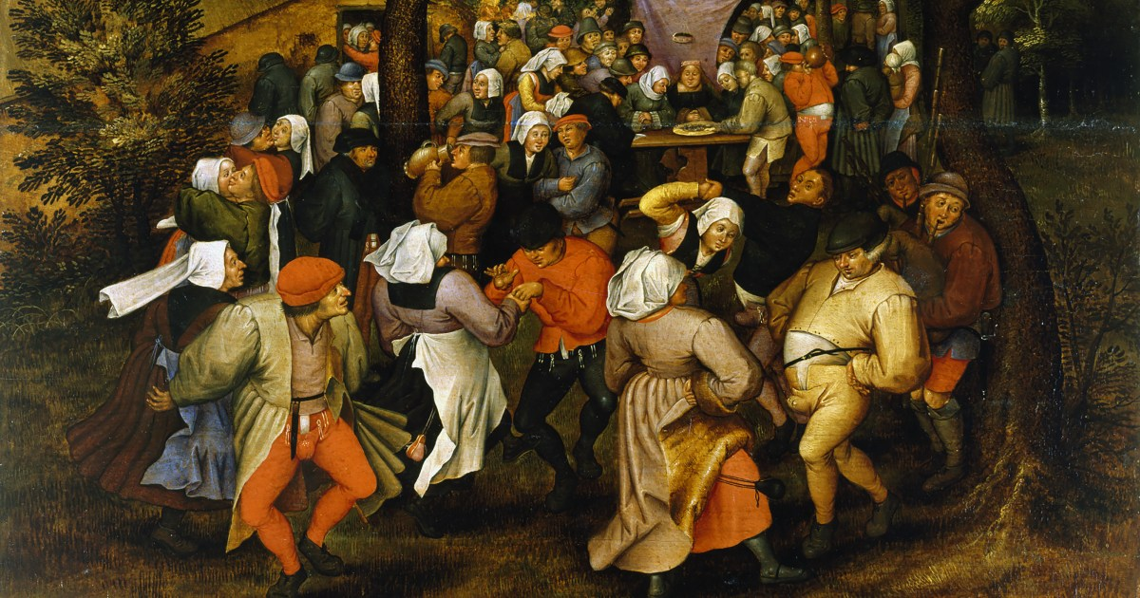
The Dancing Plague
In July 1518,in the city of Strasbourg ,a woman began dancing widely in the street and she could not stop…within a week,dozens of people joined her…they danced day and night…many collapsed from exhaustion,heart attack,or strokes..it lasted nearly month..beyond science many believes it as supernatural……

Slide 6


Slide 7


